Slide 1


Child-Flourish
Integrated Learning, Emotional Intelligence Platform
Project ID : 24-25J-188

Slide 2









OUR TEAM
Our Team
Ms. Malithi Nawarathne
K.R.K Vidyaratna
IT21295706
LEADER
(+94) 772256676
it21295706@my.sliit.lk
Siriwardana K.D.S.P
IT21293894
(+94) 71 088 8133
it21293894@my.sliit.lk
Prof.Pradeep Abeygunawardhana
SUPERVISOR
Ms. Malithi Nawarathne
CO – SUPERVISOR
Dr.Nilushi Weerapperuma
EXTERNAL SUPERVISOR
Prasadi P.G.K.R
IT21302626
(+94) 70 594 5095
it21302626@my.sliit.lk
Dulangi G.K.N
IT21277290
(+94) 77 0431140
it21277290@my.sliit.lk

Slide 3

Research Problem
Parents often struggle to balance work with their children's early education and development, especially for kids aged 8 to 11, a crucial period for social, emotional, and cognitive growth.

Slide 4
Background
There’s a need for improved methods to identify and support children with Autism Spectrum Disorder (ASD) and ADHD.
There is a growing recognition of the need for innovative educational tools that enhance cognitive development.
Sri Lankan parents would benefit from flexible, adaptive educational solutions that address both developmental and educational needs.

Slide 5
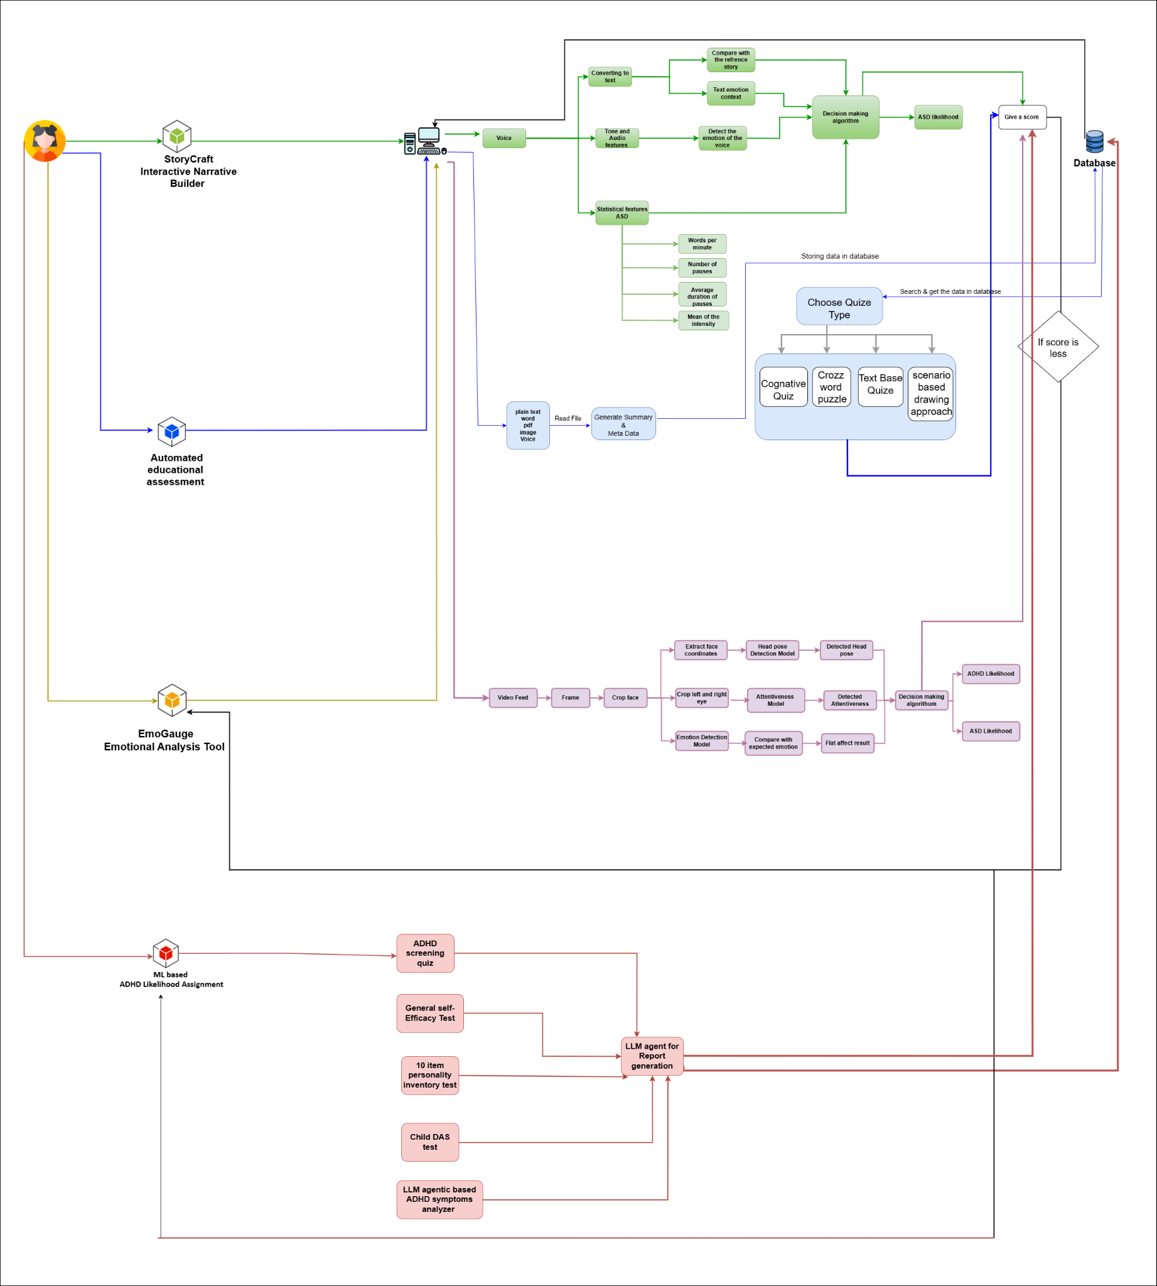
System Overview

Slide 6
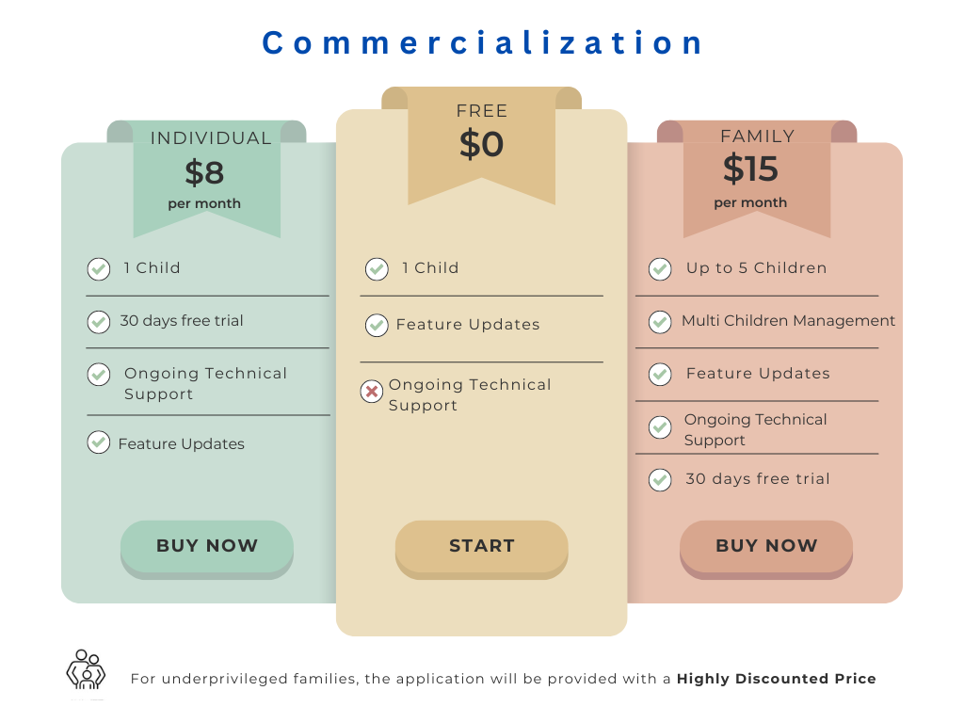

Slide 7
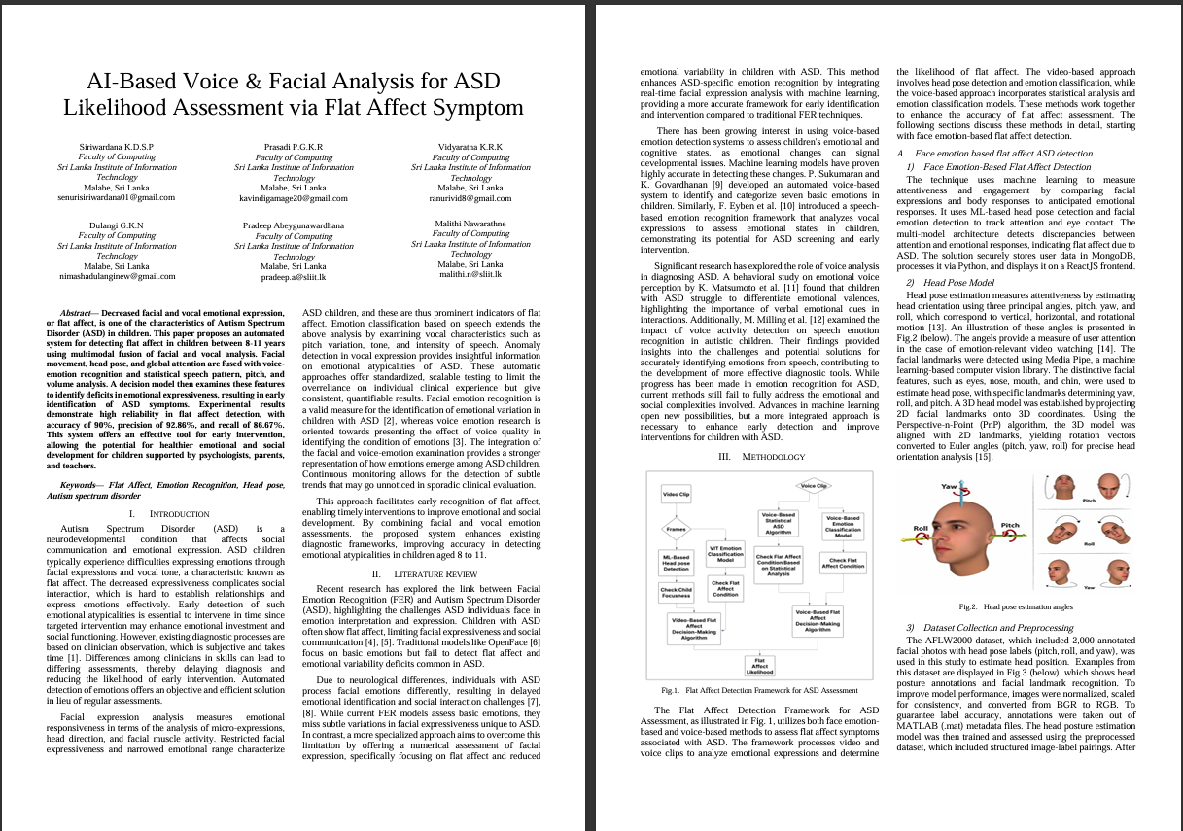

Research Paper
Research Paper
The Accepted Conference
IT21302626 | Prasadi P.G.K.R | 24-25J-188

Slide 8
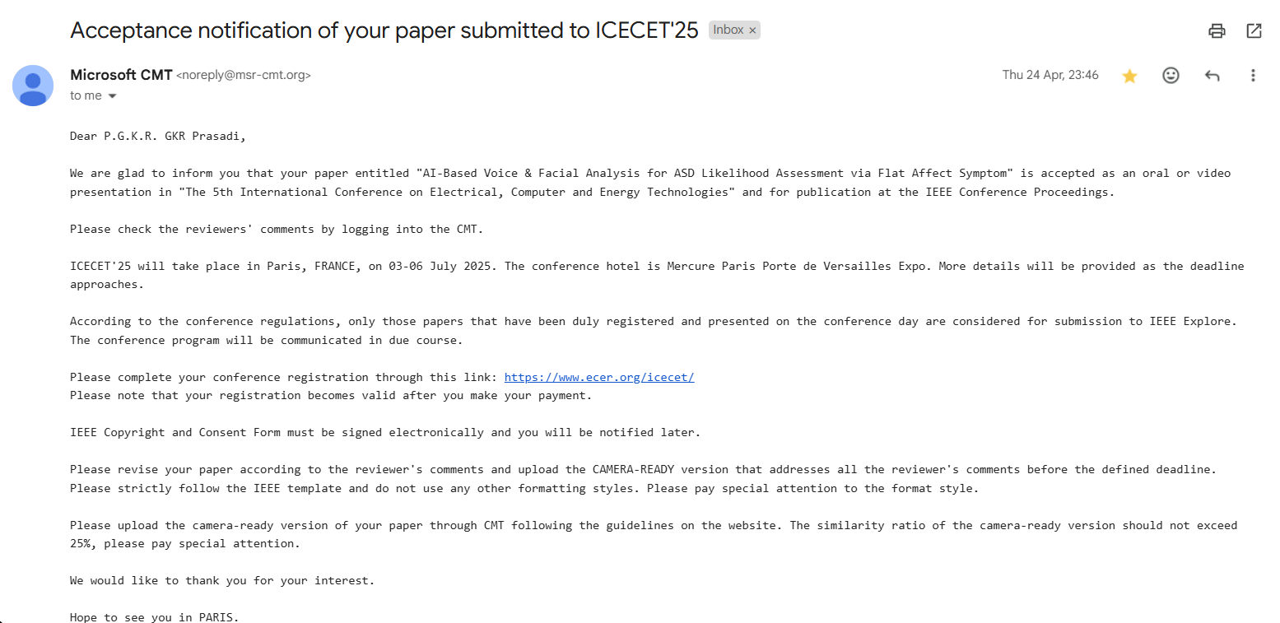
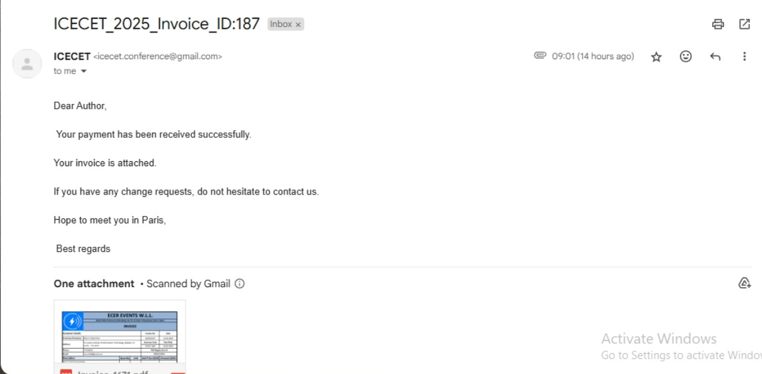
Research Paper
Acceptance Notification
Register Confirmation mail
IT21302626 | Prasadi P.G.K.R | 24-25J-188

Slide 9

Individual Components

Slide 10
Component 1
ML based ADHD Likelihood Assignment
IT21295706
K.R.K Vidyaratna
Information Technology

Slide 11

Introduction
Helps early identification of ADHD in children
Goal is to utilize machine learning to predict the likelihood of ADHD based on behavioral data.
Designed to evaluate factors linked to ADHD risk in children through a comprehensive series of questionnaires filled by the parent.
IT21295706 | Vidyaratna K.R.K | 24-25J-188

Slide 12
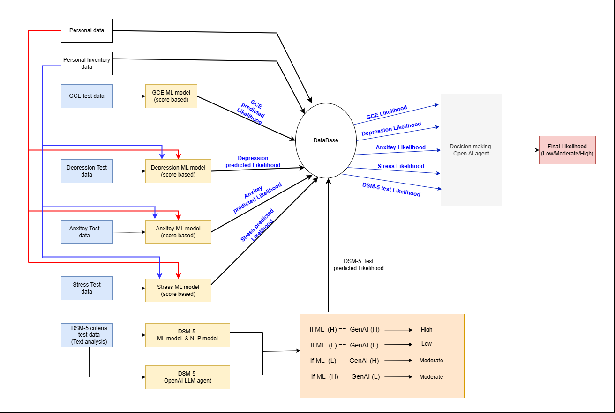
System Diagram
IT21295706 | Vidyaratna K.R.K | 24-25J-188

Slide 13
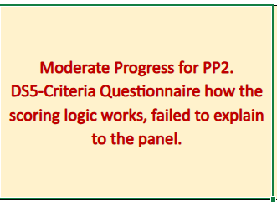
Panel Comment
1. Component is now developed to a broader scope which was questioned in pp2.
The system now will be using user’s personal data and personality data for the prediction along with the test results in each of the following test;
Depression test
Anxiety test
Stress test
Considering a broader scope of user data to predict the likelihood more accurately.
2.DSM-5 criteria is now predicted more accurately with the help of a new NLP model along with the existing GenAI LLM Agent
IT21295706 | Vidyaratna K.R.K | 24-25J-188

Slide 14
Key Challenges
Upgrading the system to do a broder user data analysis to predict likelihood in DAS tests, with and without the scoring system.
Training a new NLP ML model to to predict DSM-5 criteria likelihood more accurately along with the existing GenAI LLM agent
IT21295706 | Vidyaratna K.R.K | 24-25J-188

Slide 15
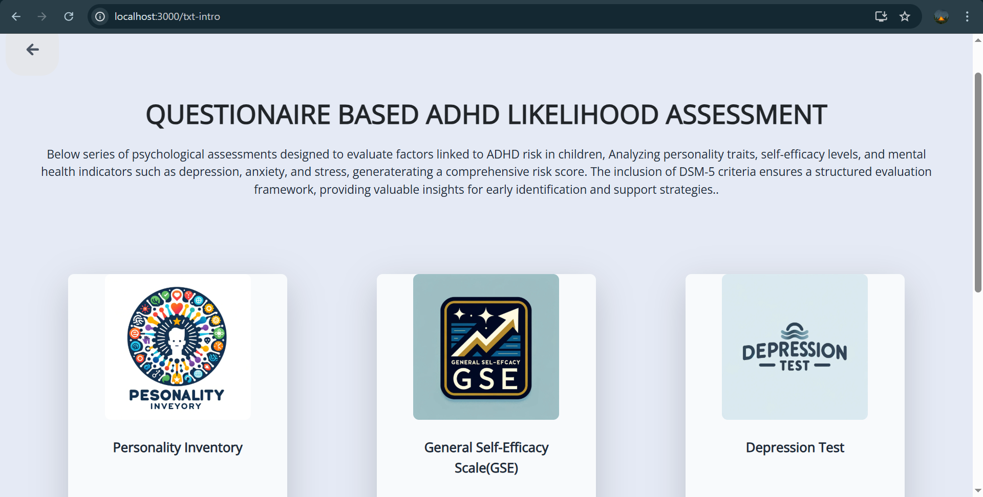
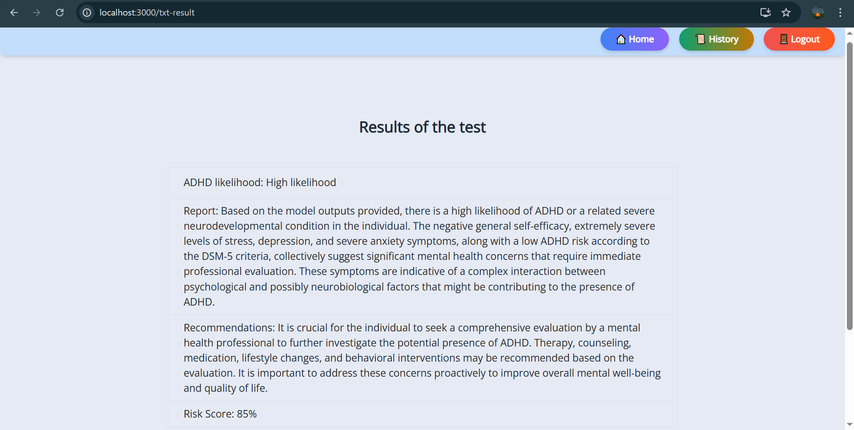
Proof of Concept
ADHD Likelihood Assessment Questionnaires
ADHD Final Risk Score Prediction
IT21295706 | Vidyaratna K.R.K | 24-25J-188

Slide 16
Component 2
Facial Emotion-Based ASD Flat Affect Likelihood Recognition
(EmoGauge)
IT21293894
Siriwardana K.D.S.P
Information Technology

Slide 17
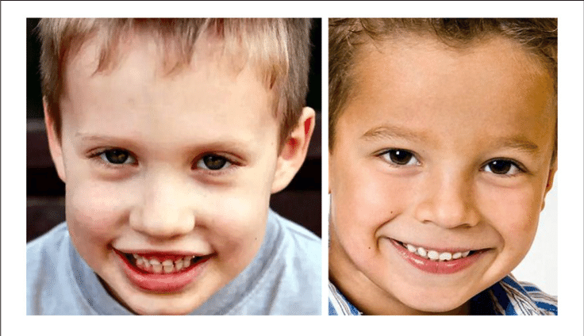

Introduction
Provide an indication of the likelihood of Autism Spectrum Disorder (ASD) by measuring flat affect in children aged 8 to 11.
Flat affect is a symptom where a person doesn't express emotions in the same way as others.
By using an emotion detection approach, facial expressions are analyzed to identify flat affect.
IT21293894 | Siriwardana K.D.S.P | 24-25J-188

Slide 18
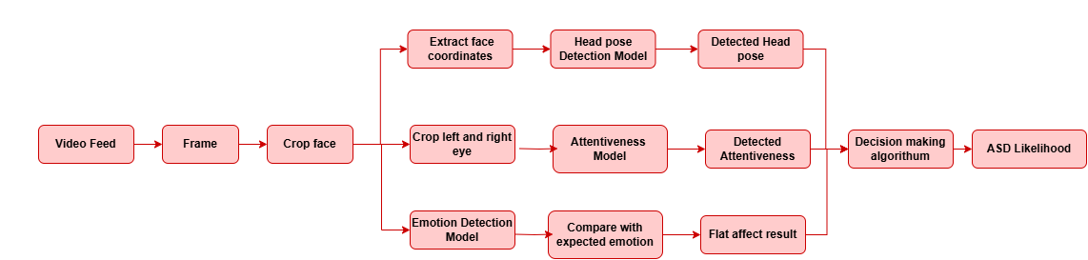
System Diagram
IT21293894 | Siriwardana K.D.S.P | 24-25J-188

Slide 19
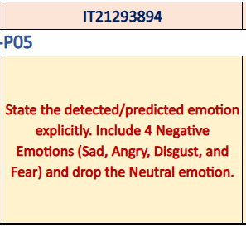
Panel Comments
System explicitly states the detected and predicted emotions, clearly identifying both positive and negative categories, including Sad, Angry, Disgust, and Fear.
Neutral cannot be excluded, as its removal led to data loss and reduced accuracy.
Final decision - Neutral' was changed to 'calm' as it is psychologically appropriate and technically valid for children
IT21293894 | Siriwardana K.D.S.P | 24-25J-188

Slide 20
Key Challenges
High Processing Time – Real-time emotion analysis requires significant computational power, leading to delays.
Lighting & Environmental Factors – Poor lighting or background distractions affect detection reliability.
IT21293894 | Siriwardana K.D.S.P | 24-25J-188

Slide 21
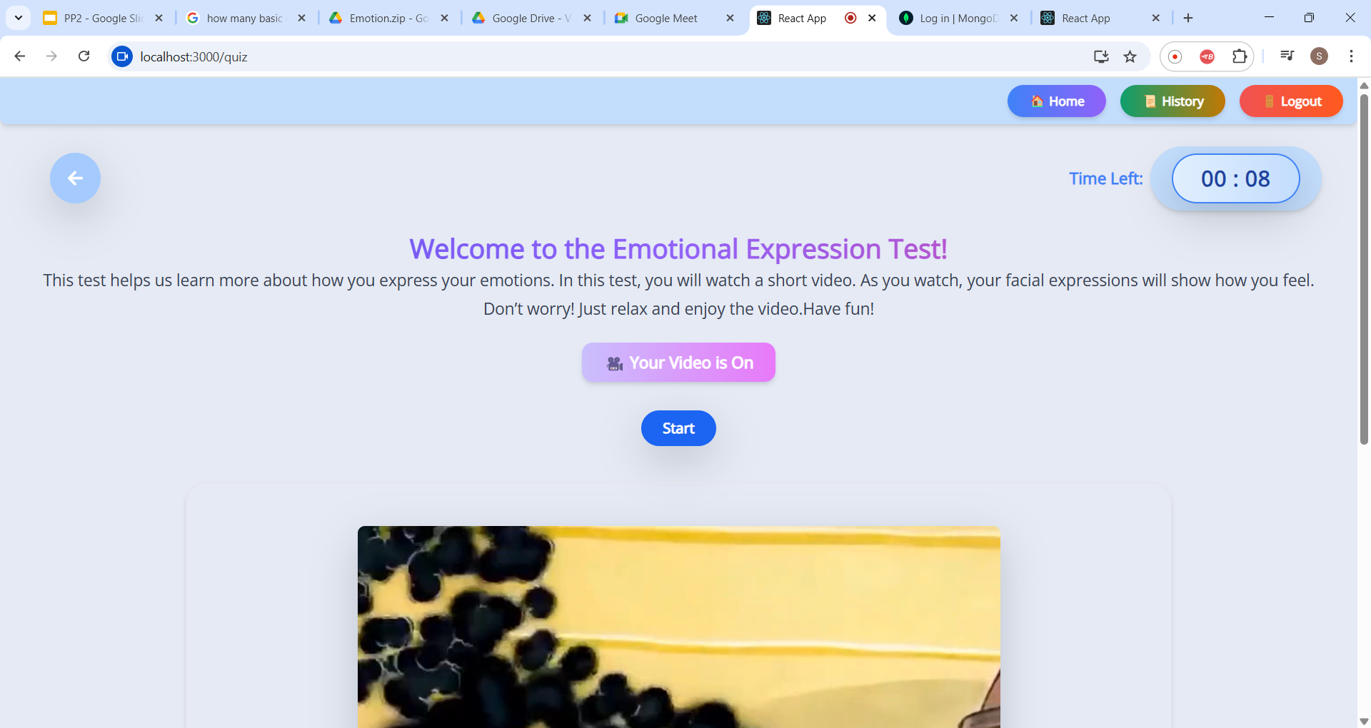
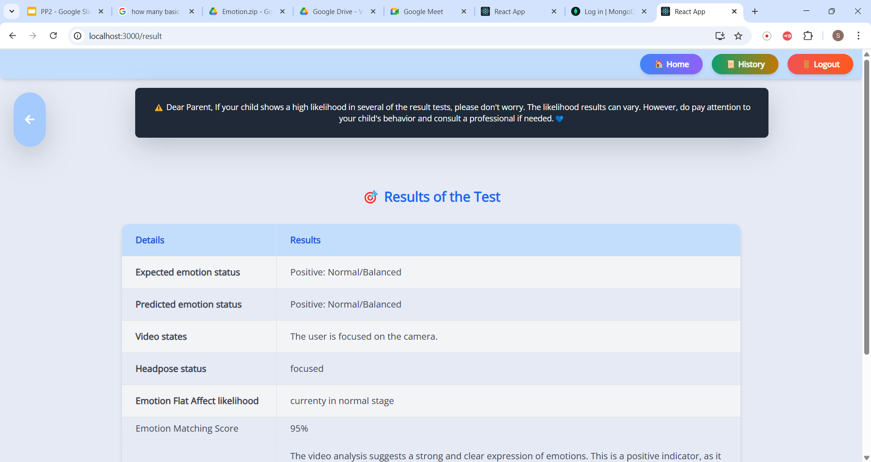
Proof of Concept
Capturing the user's emotions in real time using a webcam
Result of the test
IT21293894 | Siriwardana K.D.S.P | 24-25J-188

Slide 22
Component 3
Voice Emotion-Based ASD Flat Affect Likelihood Recognition
(StoryCraft)
IT21302626
Prasadi P.G.K.R
Information Technology

Slide 23
Introduction
Analyzes speech features and emotional context to evaluate children's emotional responses, and flat affect, which is commonly observed in individuals with Autism Spectrum Disorder (ASD).
Designed for children aged 8 to 11, it supports their educational development by improving grammar and emotional expressiveness.
IT21302626 | Prasadi P.G.K.R | 24-25J-188

Slide 24
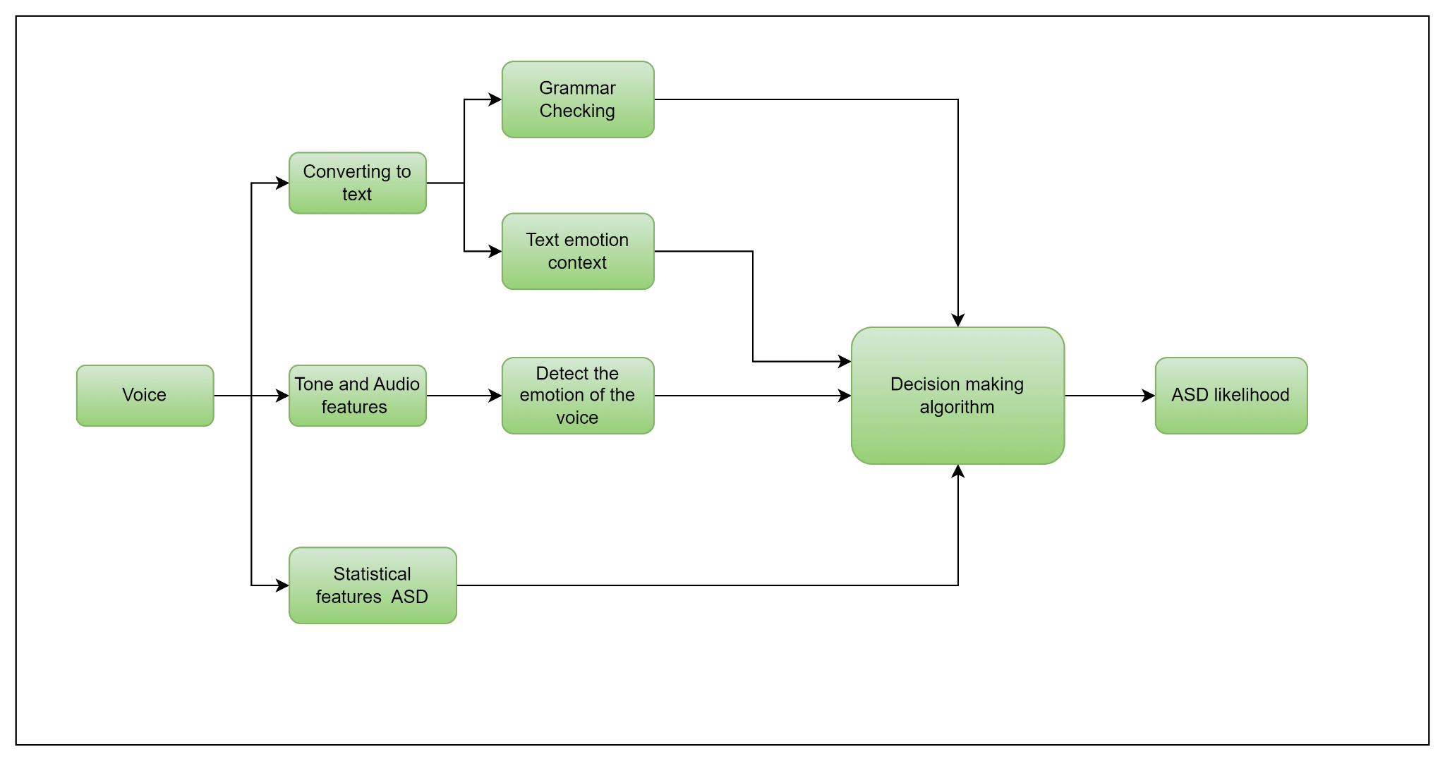
System Diagram
IT21302626 | Prasadi P.G.K.R | 24-25J-188

Slide 25
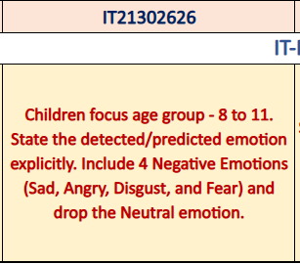
Panel Comments
For this age group, only one sentence can be reliably predicted at a time.
Final detected emotions include 4 negative classes
🔹 Sad 🔹 Angry 🔹 Disgust 🔹 Fear
Neutral cannot be dropped – its removal caused data loss and low accuracy.
Final decision - Redefine "neutral" as "calm" – psychologically and technically valid for children aged 8–11.
IT21302626 | Prasadi P.G.K.R | 24-25J-188

Slide 26
Key Challenges
Limited Voice Input Duration – The system can only capture and analyze up to 10 seconds of speech due to the need for efficient processing and real-time feedback.
Speech Variability and Noise – Background noise, unclear pronunciation, and individual differences in speech patterns can impact the accuracy of vocal emotion detection.
IT21293894 | Siriwardana K.D.S.P | 24-25J-188

Slide 27
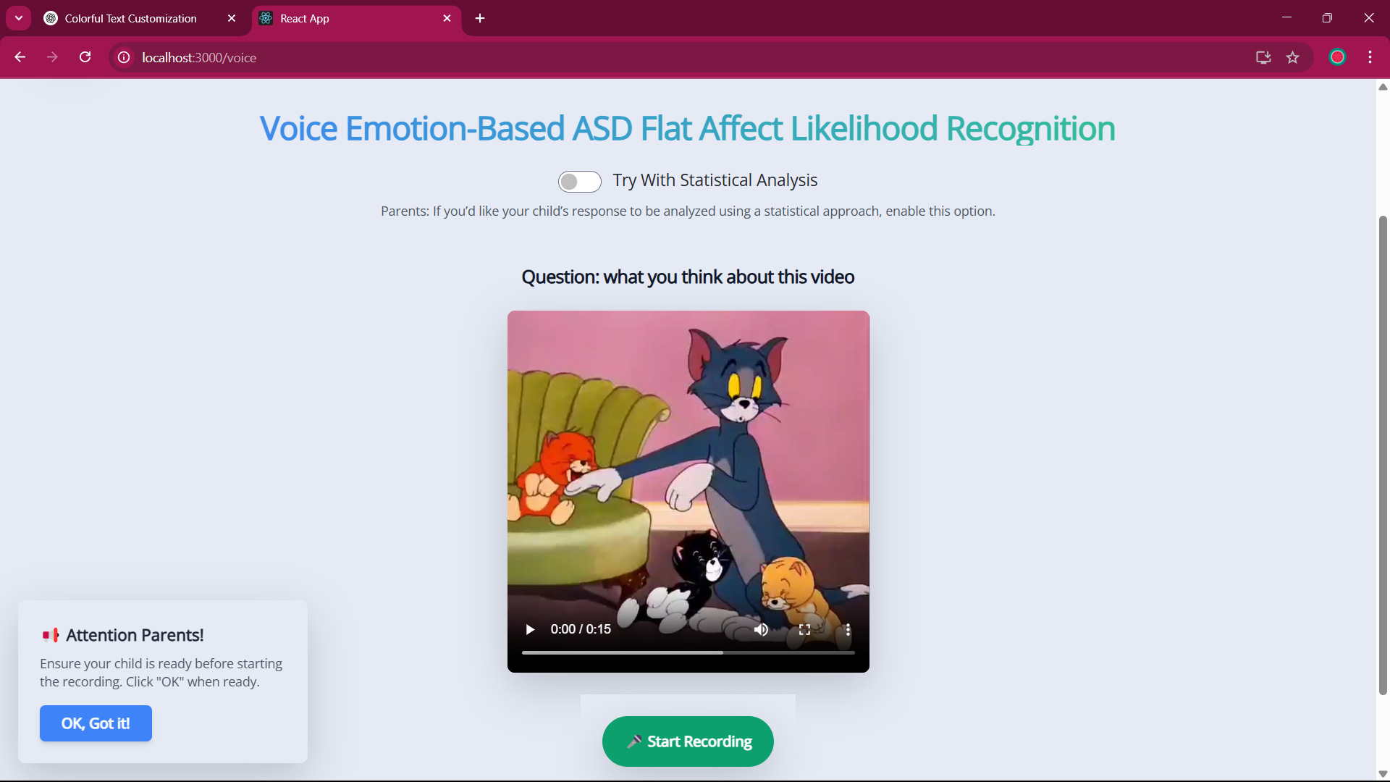
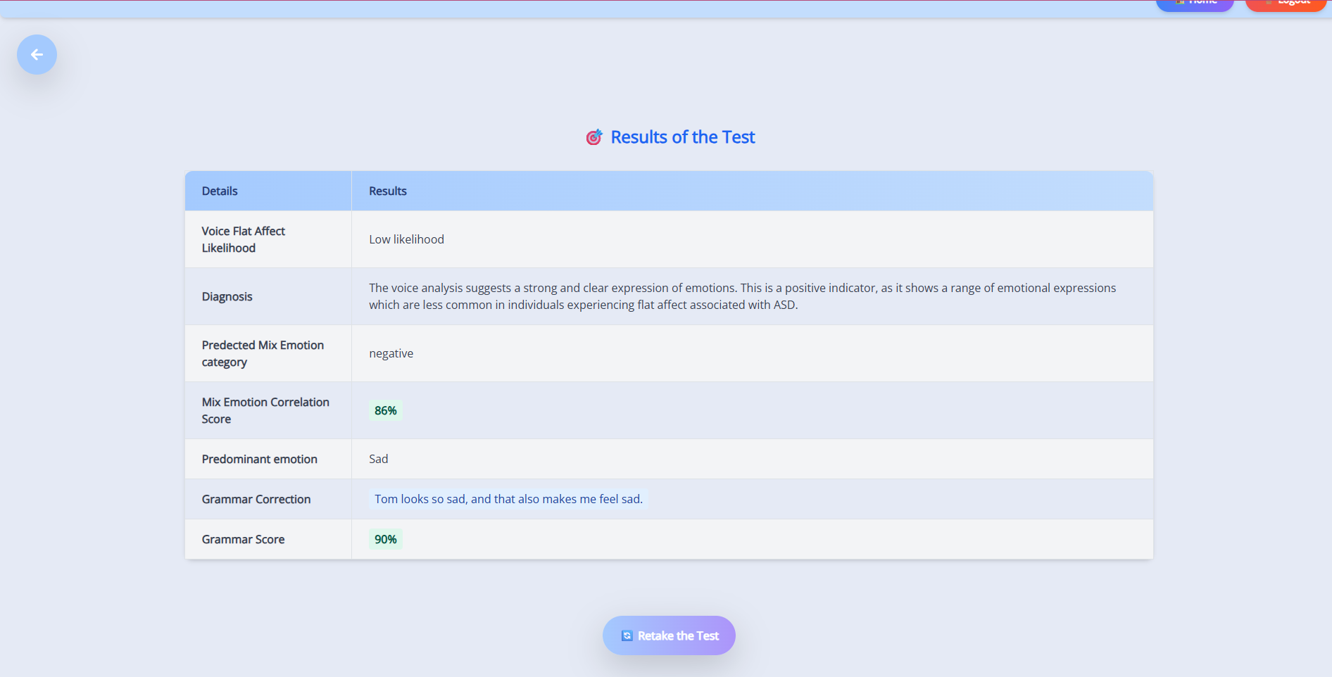
Proof of Concept
Recording the child’s voice emotions in real time
Result of the test
IT21302626 | Prasadi P.G.K.R | 24-25J-188

Slide 28
Component 4
Automated Educational Assessment System for Cognitive Development
IT21277290
Dulangi G.K.N
Information Technology

Slide 29
Introduction
This is focusing on enhancing children’s learning through personalized assessments while also identifying potential cognitive and emotional challenges like ADHD , ADD likelihood
IT21277290 | Dulangi G.K.N | 24-25J-188

Slide 30
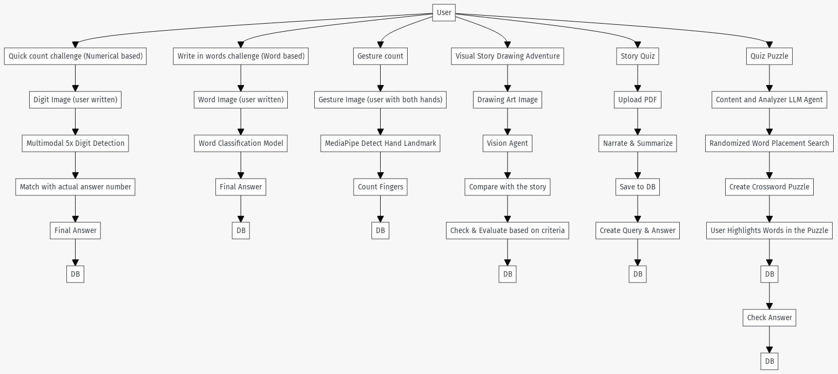
System Diagram
IT21277290 | Dulangi G.K.N | 24-25J-188

Slide 31


Deliverables
Final Presentation
Quick count challenge
Write in word challenge
Gesture count challenge
Visual story drawing challenge
MCQ-type quiz generation
Cognitive quiz approach
Quiz puzzle
IT21277290 | Dulangi G.K.N | 24-25J-188

Slide 32
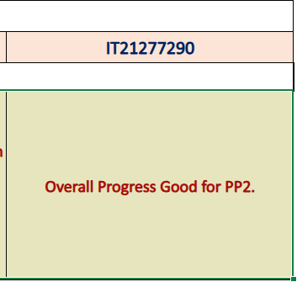
Panel Comment
IT21277290 | Dulangi G.K.N | 24-25J-188

Slide 33
Key Challenges
Lighting & Environmental Factors – Poor lighting or background distractions affect detection reliability. As you can see in this gesture counting interface, poor lighting conditions can impact the camera's ability to accurately detect hand landmarks and finger counting.
IT21277290 | Dulangi G.K.N | 24-25J-188

Slide 34

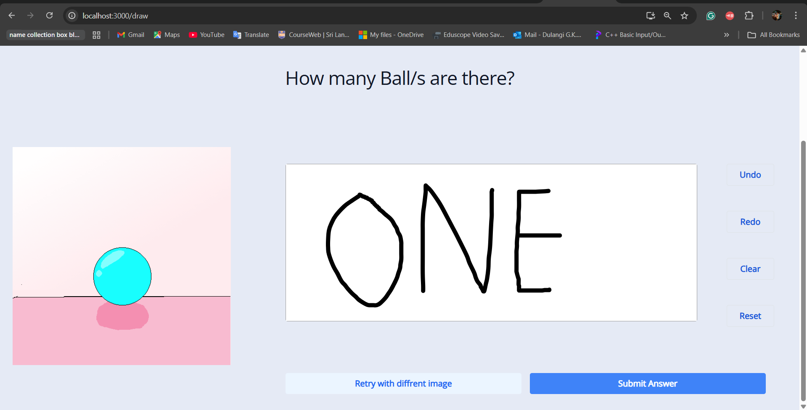
Proof of Concept
Digit Prediction
Digit Prediction
IT21277290 | Dulangi G.K.N | 24-25J-188

Slide 35

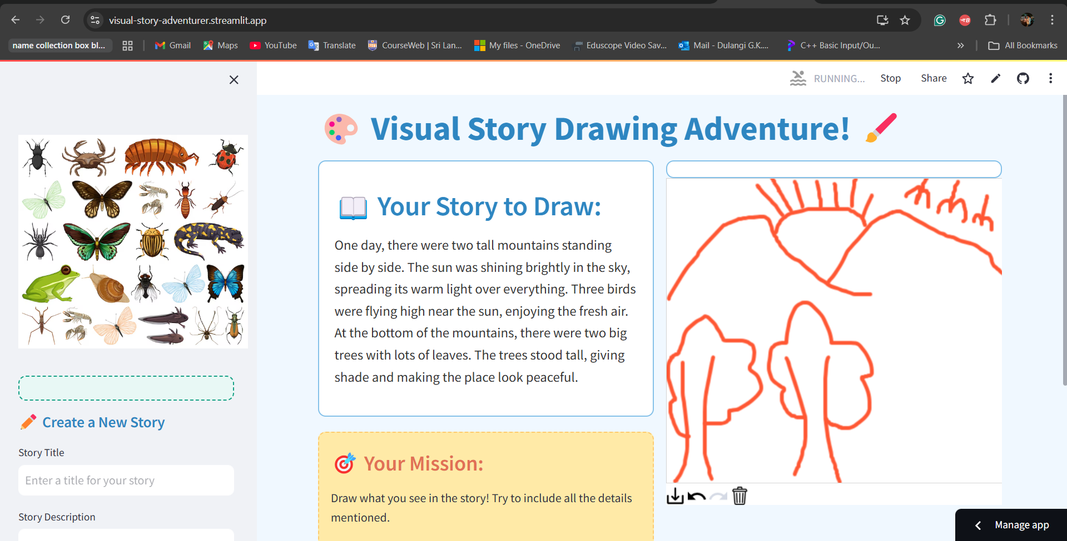
Proof of Concept
Quiz Buddy
Story Drawing
IT21277290 | Dulangi G.K.N | 24-25J-188

Slide 36


THANK YOU!

